Slide 1
Digital Portfolio
STUDENT NAME: S.REKHA
REGISTER NO :2422J1250
NMID: 3CAD749FD5426AE873D42E45C71F5F8C
DEPARTMENT: BCA
COLLEGE:DR.R.V ARTS AND SCIENCE COLLEGE/
BHARATHIAR UNIVERSITY

Slide 2
PROJECT TITLE
DATA SCIENTISTS

Slide 3


AGENDA
Problem Statement
Project Overview
End Users
Tools and Technologies
Portfolio design and Layout
Features and Functionality
Results and Screenshots
Conclusion
Github Link
3/21/2024 Annual Review

Slide 4
PROBLEM STATEMENT
A problem statement for data scientists clearly defines a real-world business or research problem that can be addressed using data science methods. It typically outlines the objective, context, data availability, and success metrics.

Slide 5
PROJECT OVERVIEW
A project overview for data scientists provides a high-level summary of a data science project. It helps stakeholders (technical and non-technical) understand what the project is about, why it's important, and how it will be executed.

Slide 6

WHO ARE THE END USERS?

Slide 7
TOOLS AND TECHNIQUES
*Tools :* 1. *Python* – Most widely used for data analysis, modeling, and automation. 2. *SQL* – Essential for extracting and manipulating data from databases.
*Techniques :* 1. *Machine Learning* – For building predictive models. 2. *Data Cleaning* – Ensures accuracy and reliability of data.

Slide 8
POTFOLIO DESIGN AND LAYOUT
Showcase Skills & Tools – Highlight programming (Python, R, SQL), ML, data visualization (Tableau, Power BI), and cloud/big data tools.
Project-Centric Layout – Organize portfolio around projects with clear problem statements, methods, results, and links to code/visuals.
Professional Presentation – Clean layout including About Me, Skills, Projects, Experience
8

Slide 9
FEATURES AND FUNCTIONALITY
Data Handling & Processing – Ability to collect, clean, transform, and manage large datasets efficiently.
Analytics & Modeling – Apply statistical methods and machine learning algorithms to extract
insights and build predictive models.
Visualization & Communication – Create clear visualizations, dashboards,
and reports to communicate insights effectively to technical and non-technical audiences.

Slide 10
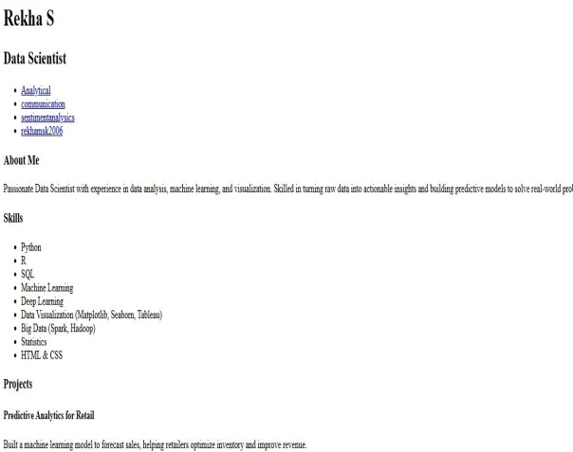
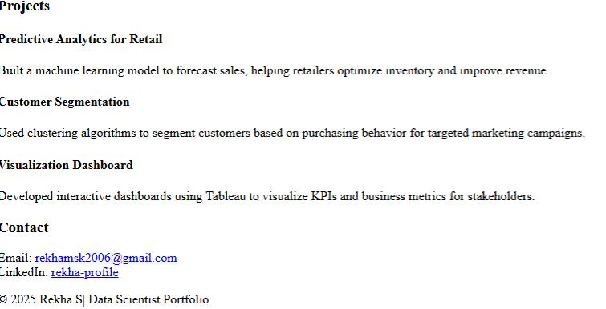
RESULTS AND SCREENSHOTS
*Insightful Decisions* – Helps businesses make data-driven, strategic choices.
2. *Predictive Power* – Enables forecasting of trends, behaviors, or risks using models.
3/21/2024 Annual Review
10

Slide 11
CONCLUSION
Data scientists turn raw data into valuable insights.*
They help businesses make smarter, data-driven decisions.
GitHub link
https://github.com/rekhamsk2006/rekha
11

